Slide 1
EE351 微机原理与微系统
姜俊敏
电子与电子工程系

Slide 2
第六章 存储器
本章学习目标
Types of Memory
Volatile Memory (RAM)
Non Volatile Memory (ROM, Flash)
Larger/Wider Memories
Memory Interfacing (Decoding)
Full Address Decoding
Partial Address Decoding
Block Address Decoding

Slide 3
Topics
Types of Memory
Volatile Memory (RAM)
Non Volatile Memory (ROM, Flash)
Larger/Wider Memories
Memory Interfacing (Decoding)
Full Address Decoding
Partial Address Decoding
Block Address Decoding

Slide 4
Resources
1 Objectives
2 Internal Resource Mapping
3 The Flash Memory Operation
4 EEPROM
5 External Memory Expansion

Slide 5
68HC812A4 Block Diagram
Port AD
Analog to Digital
1-KB SRAM
4-KB EEPROM
CPU12
Interrupts
Port T
Timer Module
I/O Ports
Port S
Serial
Communication
I/O Ports

Slide 6
CPU ­ Memory Interface
CPU ­ Memory Interface usually consists of:
uni­directional address bus
bi­directional data bus
read control line
write control line
ready control line
size (byte, word) control line
Memory access involves a memory bus transaction
read:
set address, read control signal and size signal,
copy data when ready is set by memory
write:
set address, data, write control signal and size,
done when ready is set
address bus
CPU
Memory
data bus
Read
Write
Ready
size

Slide 7
Memory Hierarchy
The design constraints on a computer memory can be summed up by three questions (i) How Much (ii) How Fast (iii) How expensive.
There is a tradeoff among the three key characteristics
A variety of technologies are used to implement memory system
Dilemma facing designer is clear → large capacity, fast, low cost!!
Solution → Employ memory hierarchy
Cost
registers
Cache
Capacity
Main Memory
Disk Cache
Access
Time
Magnetic Disk
Removable Media

Slide 8
Memory
Registers
CPU
Static RAM
Cache
Controller
Cache
Memory
Dynamic RAM
Local CPU / Memory Bus
PCI
Controller
DRAM
Co-processor
Peripheral Component Interconnect Bus
EISA/PCI Bridge
Controller
Hard Drive
Controller
Video
Adaptor
SCSI
Adaptor
EISA PC Bus
SCSI
Bus
PC Card 1
PC Card 2
PC Card 3

Slide 9
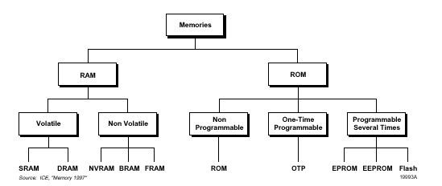
Memory Classification:

Slide 10
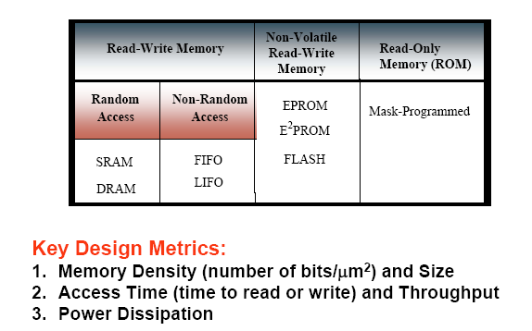
Classifications: Key Design Metrics

Slide 11
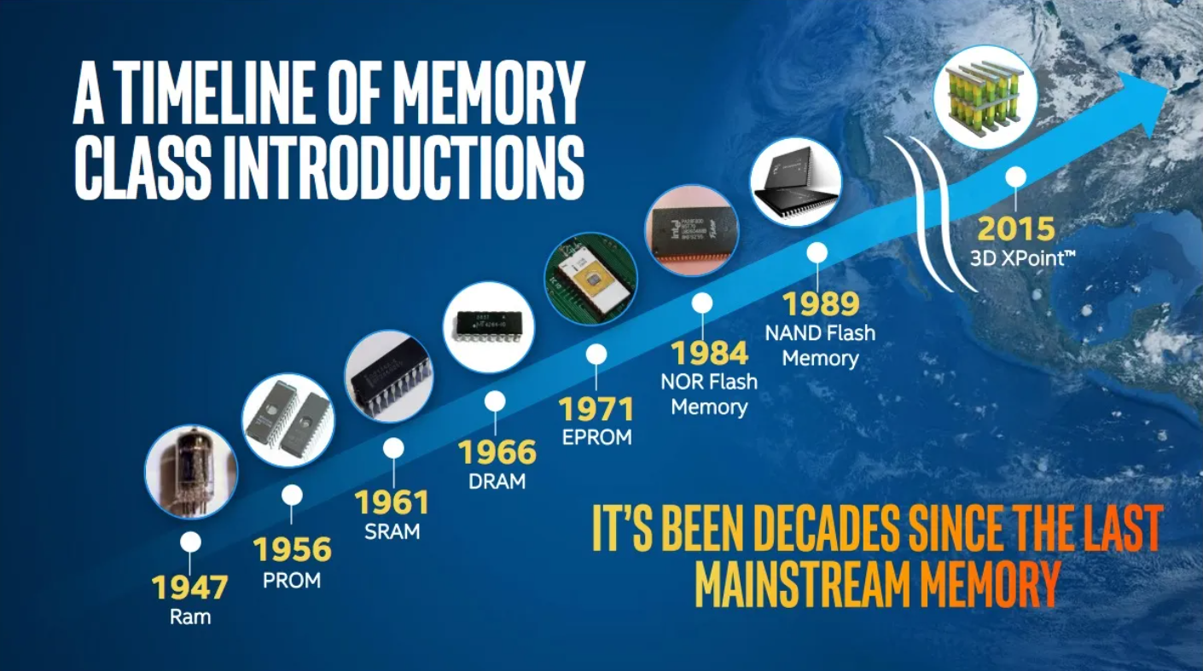
Memory Roadmap

Slide 12
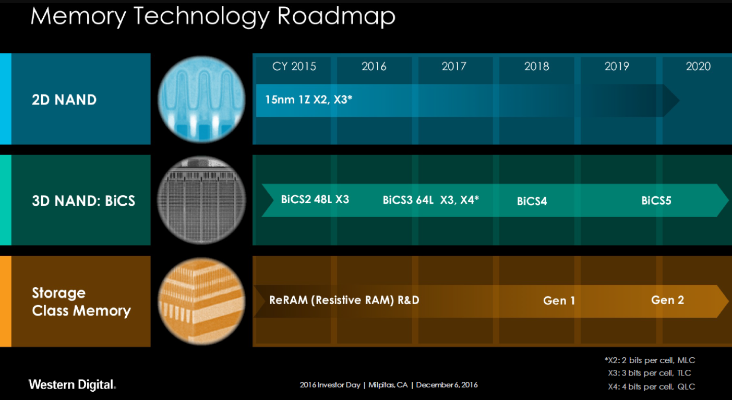
Memory Roadmap

Slide 13
RAM versus ROM
RAM
Read/write
Volatile
Faster access time
Variants
SRAM
DRAM
Application
Variables
Dynamic memory allocation
Heaps, stacks
ROM
Read only
Non-Volatile
Slower
Variants
PROM,EPROM
EEPROM, FLASH
Application
Programs
Constants
Codes, e.t.c

Slide 14
Memory Technologies
DRAM: Dynamic Random Access Memory
upside: very dense (1 transistor/capacitor per bit) and inexpensive
downside: requires refresh and often not the fastest access times
often used for main memories
SRAM: Static Random Access Memory
upside: fast and no refresh required
downside: not so dense (6 transistors per cell) and not so cheap
often used for caches
ROM: Read­Only Memory (Flash, EPROM, EEPROM)
Upside: nonvolatile
Downside: Slow to write to
often used for bootstrapping, implementing functions (SQRT)

Slide 15
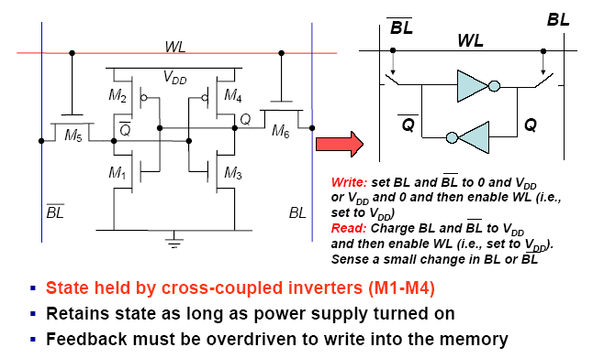
Static RAM

Slide 16
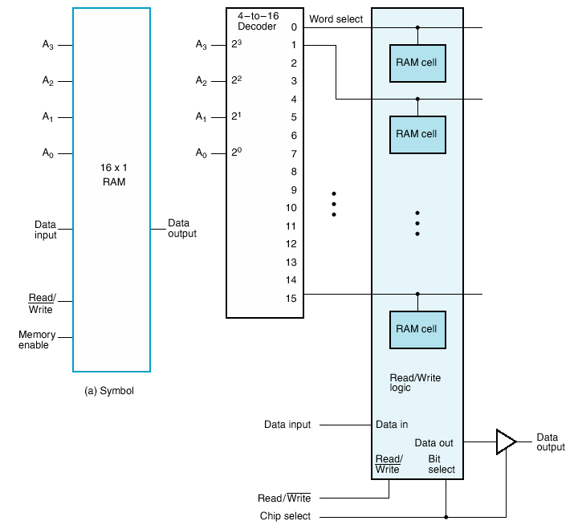
16 X 1 RAM
4 address lines required to access 16 locations.
A Decoder is added to select the different words (each 1 bit wide).
For 16 words we need a 4-to-16 line Decoder

Slide 17
Row/Column
Practical memories contains thousands of words!!
If RAM gets large, there is a huge decoder
Also run into chip layout issues
How can we change the structure of Memory to solve this problem?
Rearrange the memory into “2D” i.e., matrix layout

Slide 18
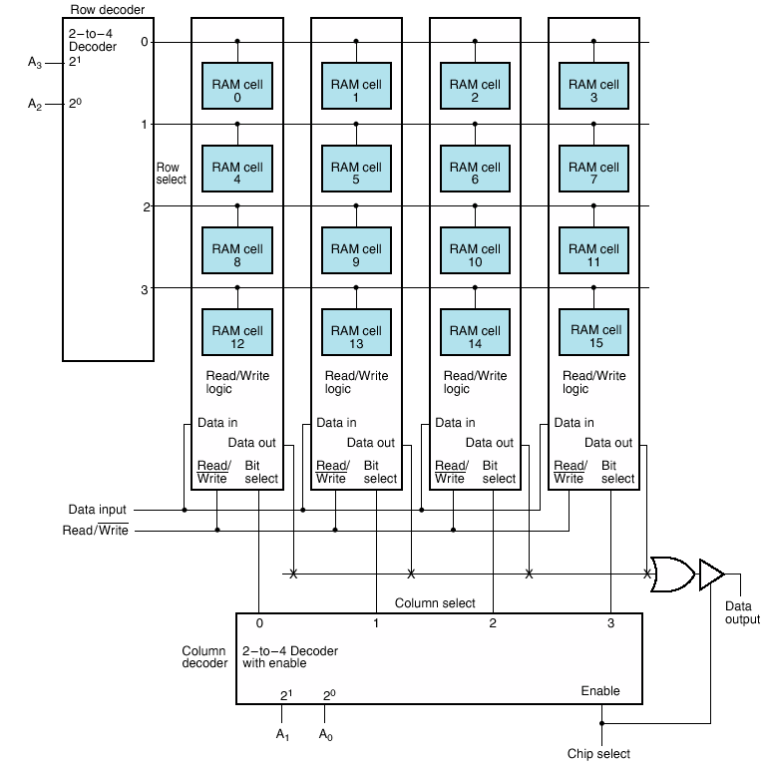
16 X 1 as 4 X 4 Array
Two decoders
Row
Column
Address just broken up
Not visible from outside

Slide 19
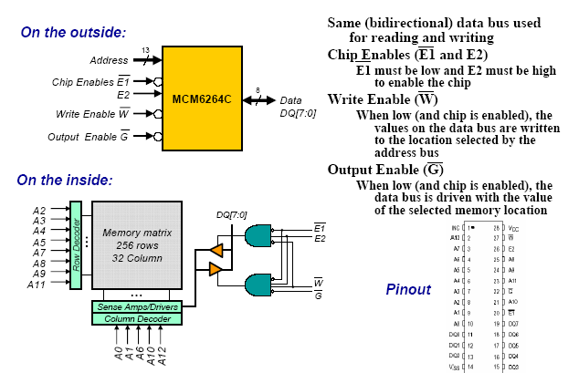
MCM6264C 8K x 8 Static RAM

Slide 20
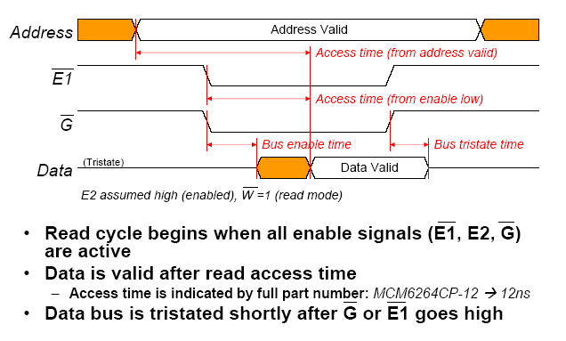
SRAM Memory Timing for Read Accesses

Slide 21
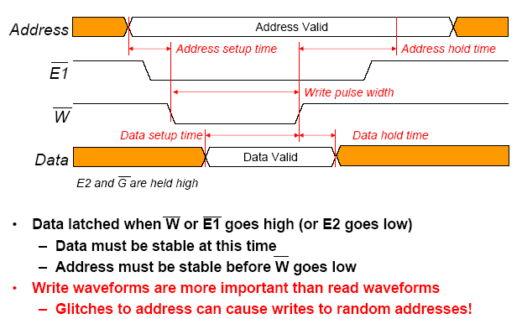
SRAM Memory Timing for Write Accesses

Slide 22
DRAM Organization and Operations
In the traditional DRAM, any storage location can be randomly accessed for read/write by inputting the address of the corresponding storage location.
Memory cell consists of a transistor and a capacitor. The charge on the capacitor represents 0 or 1 for the memory cell. The support circuitry for the DRAM chip is used to read/write to a memory cell.
A typical DRAM of bit capacity 2N * 2M consists of an array of memory cells arranged in 2N rows (word-lines) and 2M columns (bit-lines).
Each memory cell has a unique location represented by the intersection of word and bit line.

Slide 23
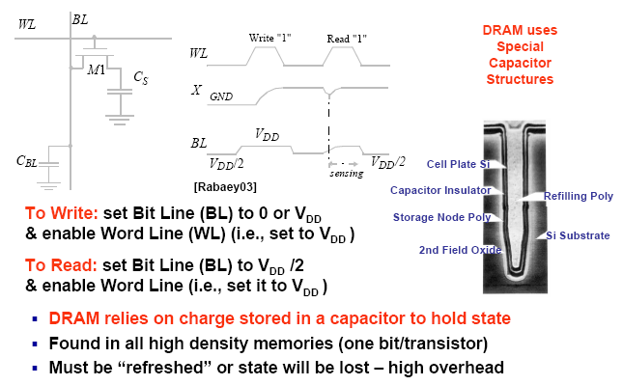
DRAM Cell

Slide 24
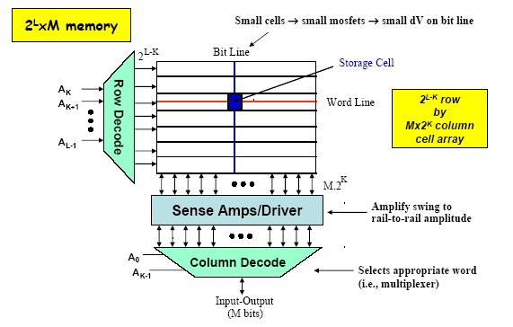
Memory Array Architecture

Slide 25
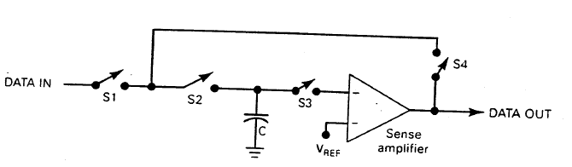
Symbolic Representation of DRAM
To write data:
Signals from address decoding R/W logic will close switches S1, S2 while keeping S3,S4 open
So input data is connected to C then switches (S1, S2) are disconnected.
To read data:
Switches S2,S3,S4 are closed while S1 is open
This connects stored capacitor voltage to sense amplifier
The sense amplifier will compare the capacitor voltage to a reference voltage and produce a solid ‘0’ or ‘1’ and C gets refreshed.

Slide 26
DRAM Characteristics
Destructive Read
When cell read, charge removed
Must be restored after a read
Refresh
Also, there’s steady leakage
Charge must be restored periodically
DRAM are dense (lots of cells) so there are many address lines.
To reduce the physical size of DRAM we can reduce the number of pins by applying the address lines serially in to parts (Row Address and then Column Address)

Slide 27
Address Multiplexing
16K x 1 DRAM → 14 address lines
64K x 1 DRAM → 16 address lines
4M x 1 DRAM → 22 address lines
High capacity memory chips require many pins if each address required a separate pin
Solution: In order to reduce # of pins on DRAM chips manufacturers utilize address multiplexing → whereby each address input pin can accommodate two different address bits.
What does this translate to?
Significant decrease in size of IC package
Better yield
Maximize the amount of memory that can fit on one board
Cheaper ICs
27

Slide 28
DRAM Memory Access
DRAM Memory is arranged in a XY grid pattern of rows and columns.
First, the row address is sent to the memory chip and latched,
then the column address is sent in a similar fashion.
This row and column-addressing scheme (called multiplexing) allows a large memory address to use fewer pins.
The charge stored in the chosen memory cell is amplified using the sense amplifier and then routed to the output pin.
Read/Write is controlled using the read/write logic.

Slide 29
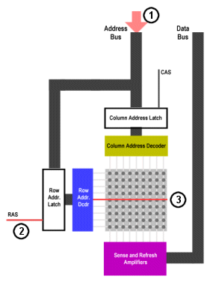
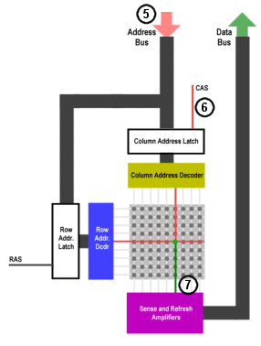
How DRAM Works
A₇A₆A₅A₄A₃A₂A₁A₀
A₇A₆A₅A₄
A₃A₂A₁A₀

Slide 30
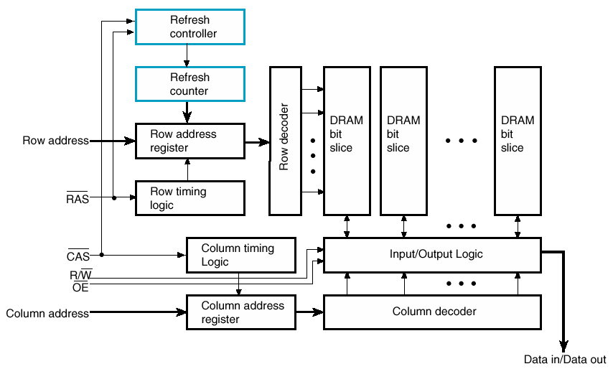
DRAM Logical Diagram

Slide 31
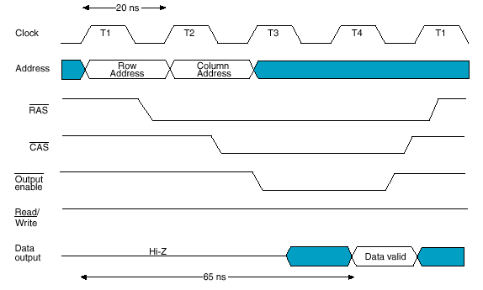
DRAM `Read’ Timing Waveform
After Applying RAS and CAS the output enable is applied to access the data
Delay until data available

Slide 32
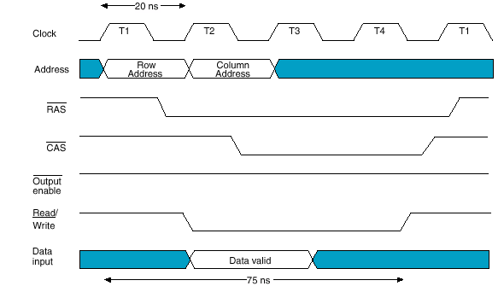
DRAM `Write’ Timing

Slide 33
DRAM Types: Synchronous vs. Asynchrnous
DRAM - Dynamic RAM
FPM DRAM - Fast page-mode RAM
EDO DRAM - Extended Data Out RAM
BEDO DRAM - Burst Extended-data-out RAM
SDRAM - Synchronous Dynamic RAM
DDRRAM - Double Data Rate RAM
DDR2 (Twice the speed of DDR SDRAM)
DDR3 (Twice the speed of DDR2 SDRAM)
DDR4 (In Production ??)

Slide 34
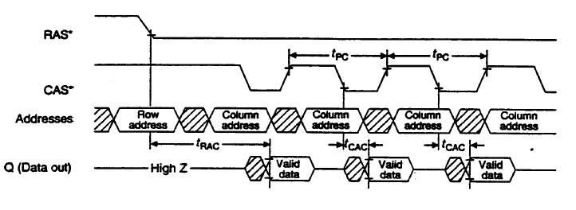
Page Mode DRAM
DRAMs made to read & write blocks
Example
Assert RAS, leave asserted
Assert CAS multiple times to read sequence of data
Similar for writes

Slide 35
DRAM Evolution (Synchronous)
There has been multiple improvements to the DRAM design in the past 10 years.
A Clock signal was added making the design synchronous (SDRAM).
The data bus transfers data on both rising and falling edge of the clock (DDR SDRAM)
Second generation of DDR memory (DDR2) scales to higher clock frequencies.
Third generation (DDR3) has lower power consumption, higher clock frequency and denser modules

Slide 36
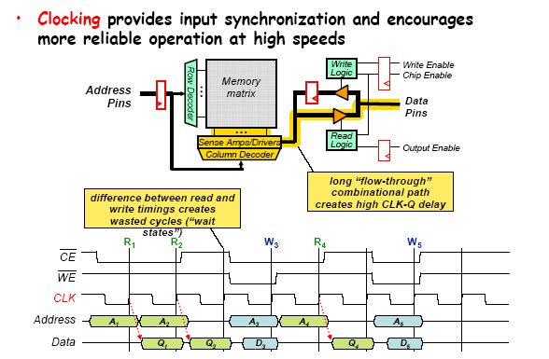
Synchronous DRAM (SDRAM)
Double Data Rate SDRAM
Transfers data on both edges of the clock

Slide 37
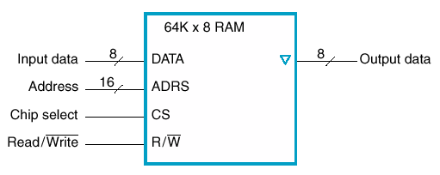
Larger/Wider Memories
Made up from sets of chips
Consider a 64K by 8 RAM
How to design a 256K x 8 RAM using a 64K ?
How many address lines in total?

Slide 38
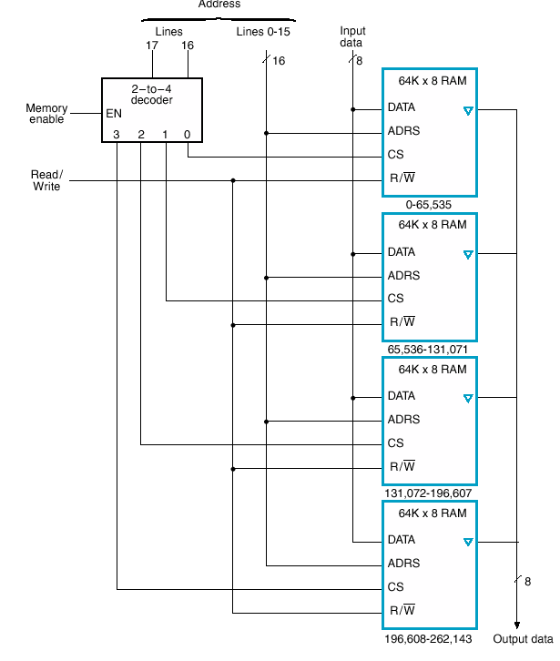
Larger Memory
256K X 8
Connect all output data lines together (tristate)
Connect all input data line together
16 lines of address to fetch a word in any DRAM chip
How to select the specific DRAM chip?

Slide 39
Larger Memory
Decoder for high-order 2 bits
Selects chip
Look at selection logic
Address ranges

Slide 40
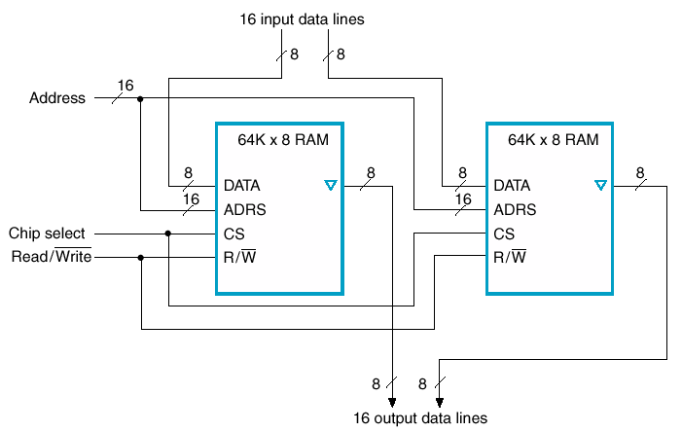
Wider Memory – 64K X 16

Slide 41
Read Only Memory

Slide 42
Mask-Programmed Devices
The entire ROM consists of a number of row (word) and column (data) lines forming an array.
Each column has a single pull-up resistor attempting to hold that column to a weak logic 1 value.
Every row-column intersection has an associated transistor and, potentially, a mask-programmed connection.

Slide 43
Fusible-Link Based PROM (OTP)
The problem with mask-programmed devices is that creating them is a very expensive unless you intend to produce them in large quantities.
For this reason, the first programmable read-only memory (PROM) devices were developed at Harris Semiconductor in 1970.

Slide 44
EPROM Technology
PROM: Programmable ROM
It can be programmed (written to) only once via a PROM programmer
EPROM: Erasable Programmable ROM
The first device – the 1702 – introduced by Intel in 1971.
It can be erased with an ultraviolet light and then rewritten via a EPROM programmer

Slide 45
Standard MOS vs. EPROM Transistor
An EPROM transistor has the same basic structure as a standard MOS transistor, but with the addition of a second polysilicon floating gate isolated by layers of oxide.

Slide 46
Non-Volatile Memories The Floating-gate transistor (FAMOS)
Floating gate
Gate
D
Source
Drain
t
ox
G
t
ox
+
+_
S
n
p
n
Substrate
Device cross-section
Schematic symbol

Slide 47
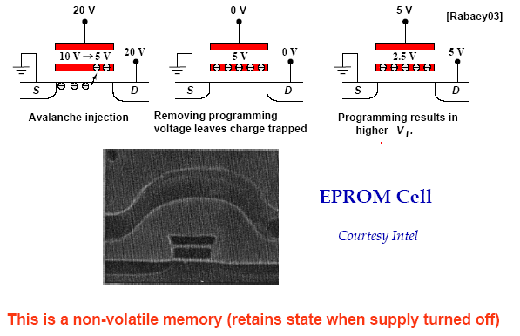
EPROM Cell: Floating Gate Transistor

Slide 48
EPROM Cell: Floating Gate Transistor
V_{t} is pushed from 0.7 volts towards 5-7 Volts. So transistor will be off unless it is reprogrammed again.
I_{ds}
V_{gs}

Slide 49
EPROM Cell: Programming/Erasing
Programming: apply a high voltage typically (10V – 25V) for a specified amount of time (typically 50 ms per address) and this requires a special programming circuit.
This will usually trap electrons in floating gate and program the bit to a ‘0’ value.
Erasing: expose the EPROM to UV light, this will force the electrons trapped (due to application of high voltage) back to silicon substrate.
This will usually take 15-20 minutes
It will erase the entire chip

Slide 50
EPROM Transistor-based Memory Cell
In its un-programmed state, all the floating gates in the EPROM transistors are uncharged.
In this case, placing a row line in its active state will turn on all of the transistors and column lines are pulled to logic “0”.

Slide 51
EPROM Transistor-based Memory Cell
As they are order of magnitude smaller than fusible links, EPROM cells are efficient in terms of silicon real estate.
An EPROM device is delivered in a ceramic or plastic package with a small quartz window in the top.
The main problem with EPROM devices are
Their expensive packages with quartz window and
The time it takes to erase them, which is in the order of 20 minutes.
To program the device or erase it, a programmer has to remove the device from the host circuit board and put onto a special programming device.
As the structures on the device become smaller and the density increases, a larger percentage of the surface of the die is covered by metal. This make it difficult for the EPROM cells to absorb the UV light and increases the required exposure time.

Slide 52
EEPROM
EEPROM (Electrically Erasable PROM) overcomes the limitations of the PROM by electrically programming and erasing the chip onboard.
The structure looks similar to the floating gate EPROM (FAMOS transistor, floating gate avalanche transistor) with some minor modifications (FLOTOX Transistor) → the insulating oxide layers surrounding this gate are very much thinner.
Programming: involves applying a high voltage
Erasing: involves applying a reverse high voltage which causes a removal of trapped charge (tunneling)

Slide 53
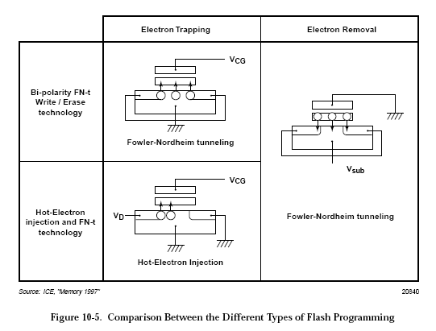
FLOTOX EEPROM
Floating gate
Gate
Source
Drain
20
–
30 nm
n
1
Substrate
n
1
p
10 nm
FLOTOX transistor
Fowler-Nordheim

Slide 54
EEPROM Cell
A second transistor is used to select cell for erasure.
Advantages: electrically erase bytes in circuit
Disadvantages: less dense than EPROM
⇨ 2 transistor cell
BL
WL
V
DD

Slide 55
FLASH (NAND vs. NOR)
The FLASH traces its ancestry to both the EPROM and EEPROM technologies (introduced in 1984/1988)
The name “FLASH” was originally coined to reflect this technology’s rapid erasure times compared to EPROM.
FLASH employs a variety of architectures.
Some have a single floating gate transistor cell with the same area as an EPROM cell, but with the thinner oxide layers characteristic of an EEPROM.
These devices can be electrically erased, but only by clearing the whole device or large portions.
Other architectures features a two-transistor cell similar to that of an EEPROM cell, thereby allowing them to be erased and reprogrammed on a word-by-word basis.

Slide 56
Flash EEPROM
Control gate
Floating gate
erasure
Thin tunneling oxide
n
1
source
n
1
drain
programming
p-
substrate
Many other options …

Slide 57
Flash EEPROM

Slide 58
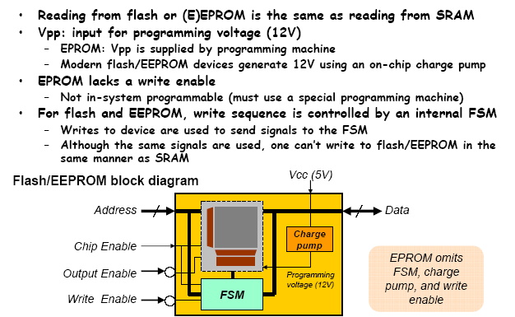
Interacting with Flash and E²PROM

Slide 59
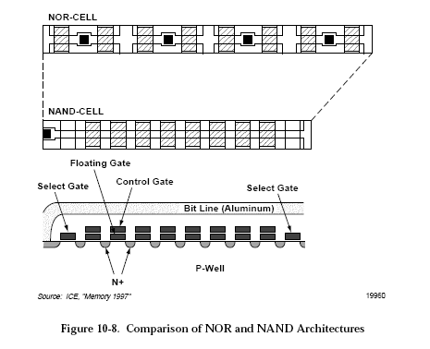
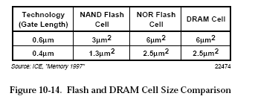
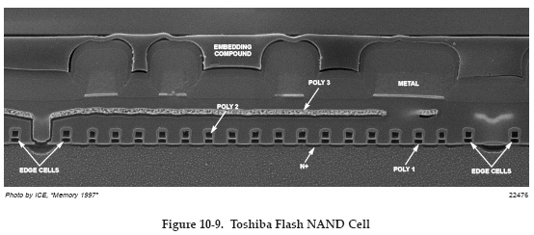
Flash EEPROM: NAND vs. NOR

Slide 60
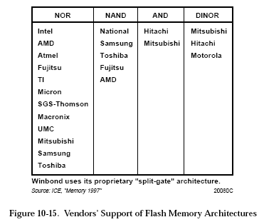
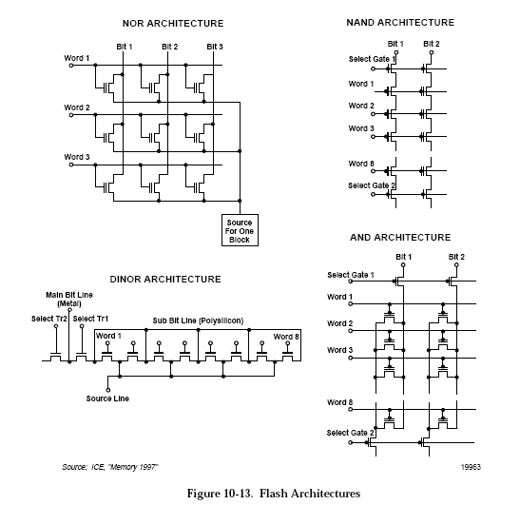
Flash EEPROM

Slide 61
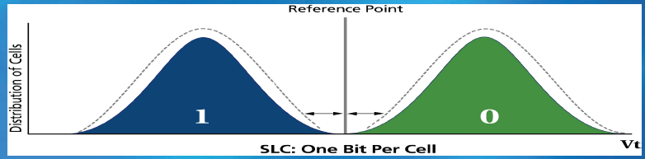
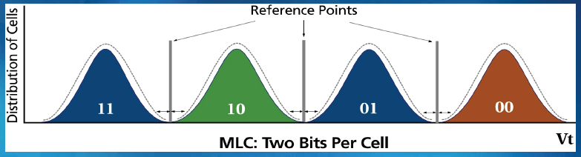
Flash EEPROM: SLC vs. MLC
Single-level (SLC) NAND stores two states per memory cell and enables one bit programmed/read per memory cell.
Multi-level cell NAND (MLC) stores four states per memory cell and enables two bits programmed/read per memory cell.

Slide 62
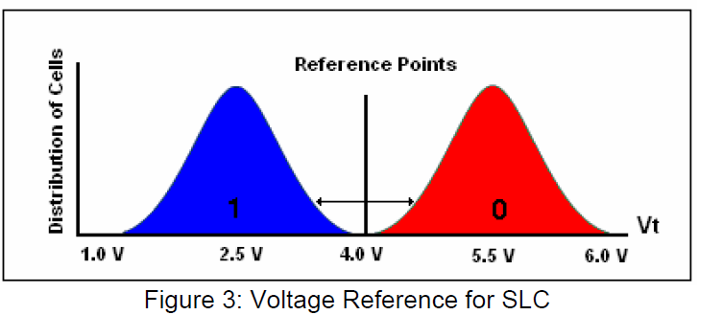
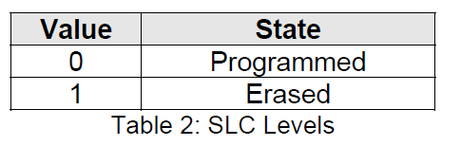
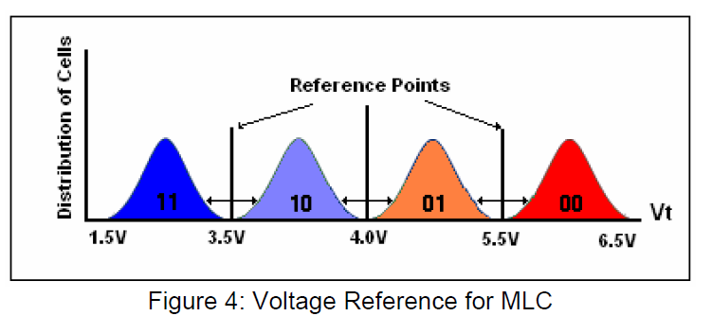
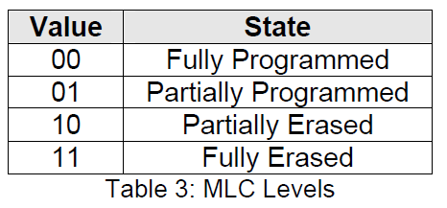
Flash EEPROM: SLC vs. MLC

Slide 63
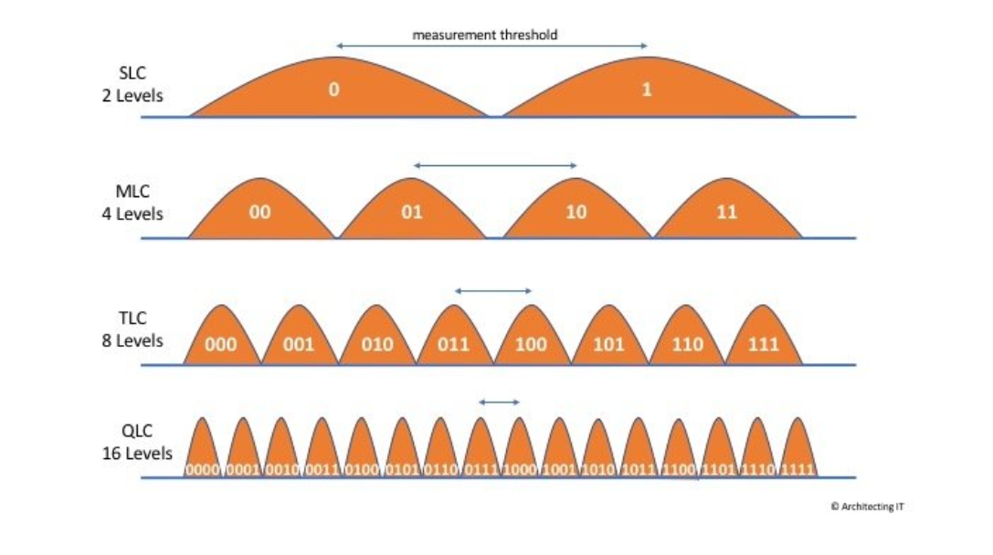
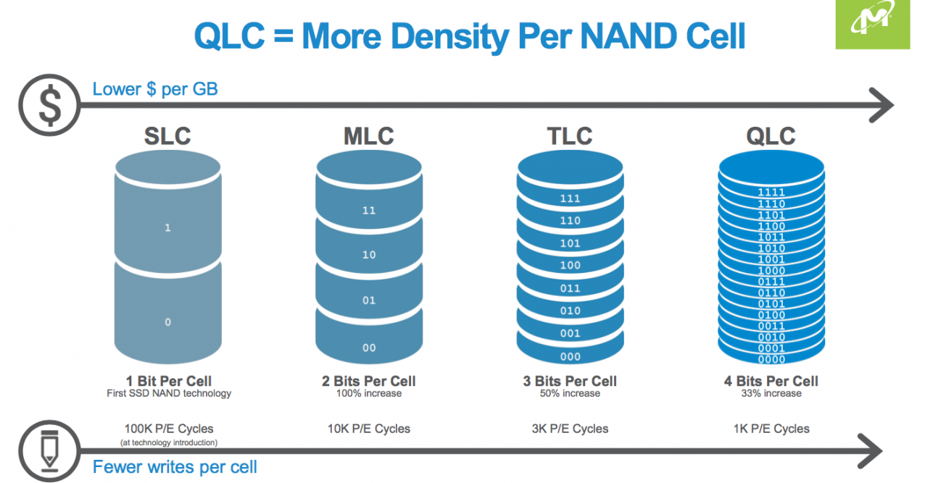
Flash EEPROM: Further

Slide 64
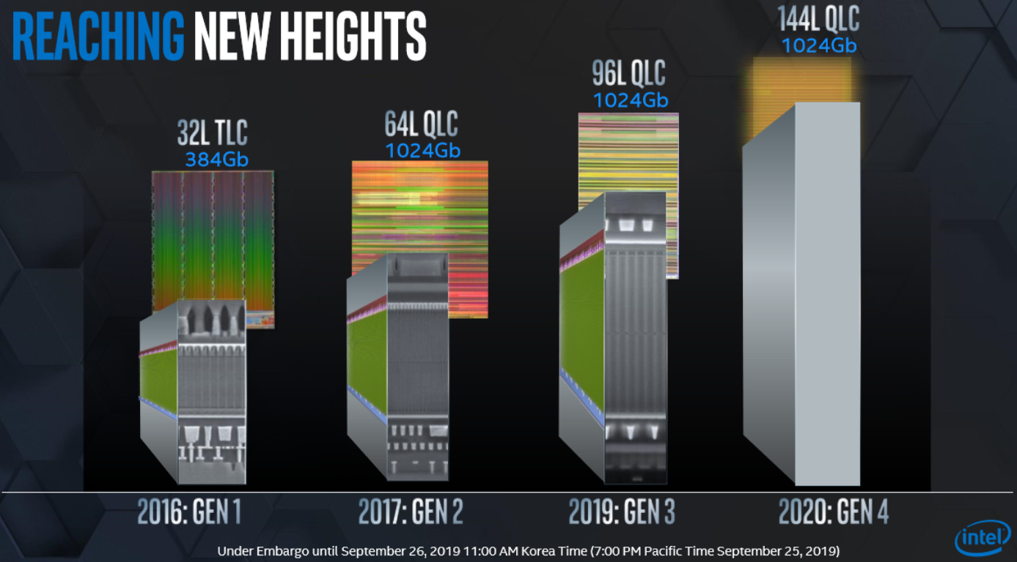
Flash EEPROM: Further

Slide 65
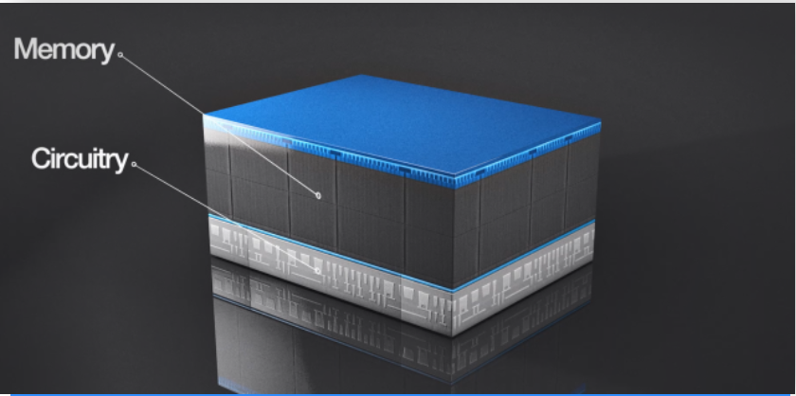
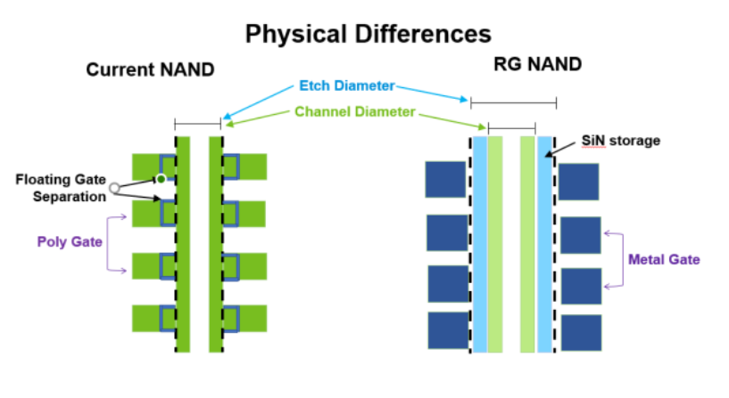
Flash EEPROM: Further
Micron’s proprietary CMOS-under-Array technique constructs the multilayered stack over the chip’s logic, packing more memory into a tighter space and shrinking 176-layer NAND’s die size, yielding more gigabytes per wafer.

Slide 66
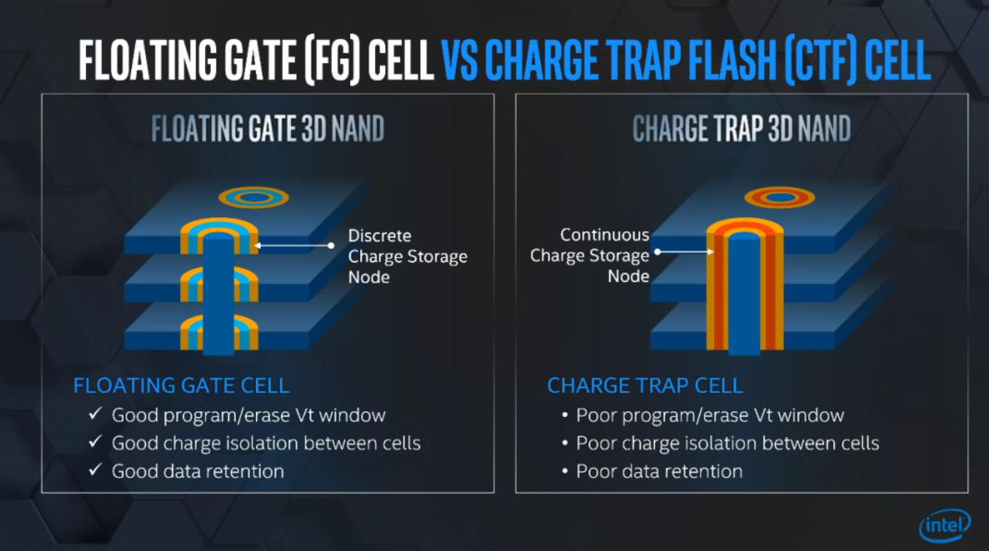
Flash EEPROM: Further
目前，NAND SSD 主要有两种结构设计，一种是英特尔 Floating Gate，另一种是 Charge Trap。这两种设计在结构上有很大不同。比如在上图中，FloatingGate 是浅蓝色部分，黄色部分是绝缘体，通过隧道效应把电子俘获到蓝色的部分当中。在 Floating Gate 技术架构下，每一层之间是断开的，而在 Charge Trap 当中，上下是靠中间的绝缘体把电荷俘获在那里，默认电子进去之后不会逃逸。在层数有限的情况下，Charge Trap 架构是可行的，当堆叠过多时，电子逃逸情况就无法保证。

Slide 67
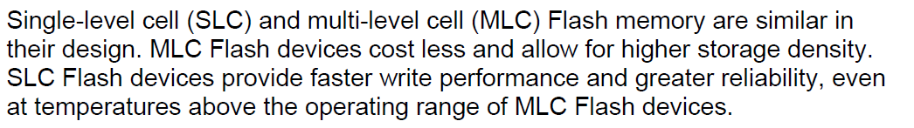
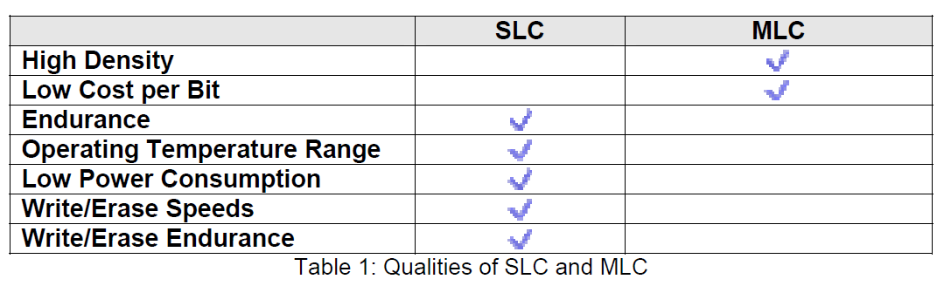
Flash EEPROM: SLC vs. MLC

Slide 68
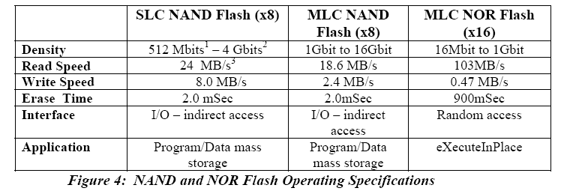
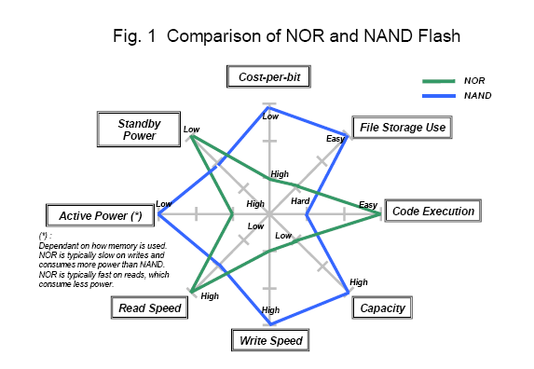
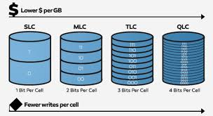
Flash EEPROM

Slide 69
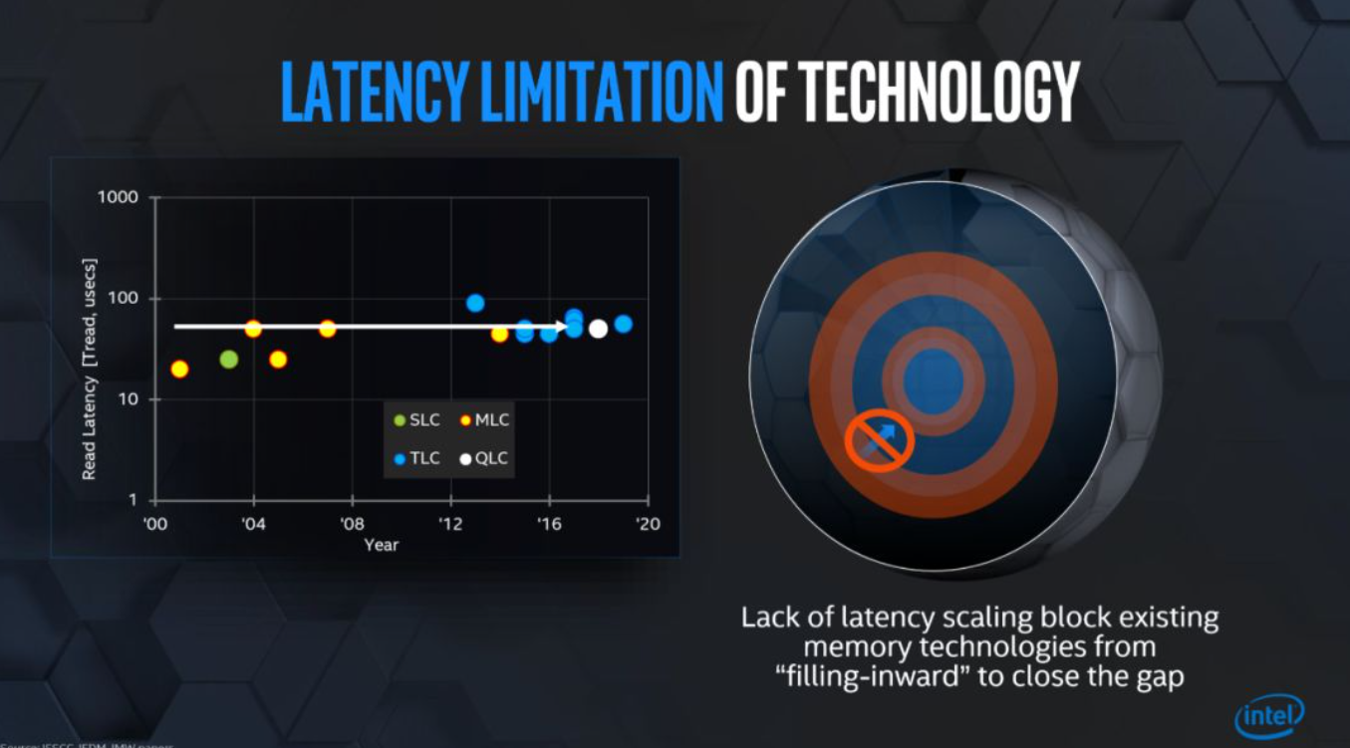
Latency of FLASH SSD
Reference: https://www.firstxw.com/view/243774.html

Slide 70
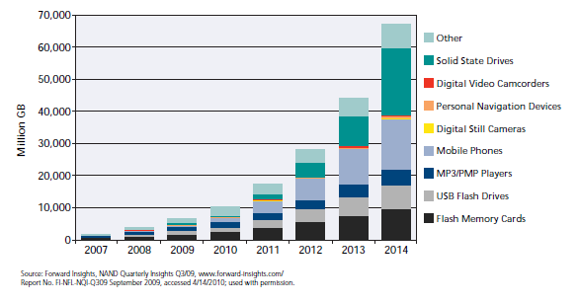
Major Markets Driving Flash
The Figure below shows how demand for NAND Flash has been driven primarily by several major markets – solid state drives, mobile phones, Flash memory cards, USB Flash drives and MP3 Players.

Slide 71
Memory: Comparison
Memory type | Density | Speed | Size | Cost | Volatility
DRAM | V.High | Slow | Small | V. Cheap | Y
SRAM | Low | V. fast | Large | Costly | Y
ROM | High | fast | Small | Cheap | N
PROM | High | fast | moderate | Cheap | N
EPROM | High | V. Slow | Small | Cheap | N
EEPROM | Medium | V. Slow | Moderate | Cheap | N
Flash | High | V. Slow | Small | Cheap | N

Slide 72
Address Decoding: Basic Concept
HC12
To transfer data correctly and protect the computer from damaging, only one device at a time should be allowed to drive the data bus. The address decoder selects and enables one and only one data transfer device at a time.

Slide 73
Address Decoding: When Needed
Address decoding is the task of designing decoding circuitry when mapping memory to different memory locations.
Required for a microcomputer where memory and I/O support are essential
Needed for embedded system when on chip microcontroller memory is not sufficient
73

Slide 74
Address Decoding: Techniques
Several techniques exist to perform address decoding
Full Address Decoding
Partial Address Decoding
Block Address Decoding
Each technique has advantages/disadvantages:
Cost
Speed
Simplicity
Future Expansion

Slide 75
Example : Full Address Decoding
SRAM1: $2000 - $3FFF
ROM1: $4000 - $5FFF
EEPROM: $6000 - $7FFF
SRAM2: $A000 - $BFFF
ROM2: $C000 - $DFFF
SRAM1
ROM1
HC12
Address bus
Data bus
Control bus
SRAM2
ROM2
EEPROM
Address decoding circuit
As the name implies you will use all the address lines to construct the decoding circuitry.

Slide 76
Designing Address Decoders
A designer can implement the address decoding techniques in several ways:
Random Logic
M-line to n-line decoders
PROMS & Programmable logic
Random Logic:
Advantages: Speed i.e. it can use the fastest logic available
Disadvantages: Requires high chip count and lacks flexibility.
Decoders: Most widely used
Examples:
74LS138 (3-to-8 line decoder)
74LS139 (dual 2-line to-4-line decoder)
74LS154 (4-to-16 line decoder)
Advantage: modular, and flexible
Disadvantage: Slower, waste of some logic

Slide 77
Full Address Decoding: Example
Design a fully decoded positive logic select signal for 1K RAM located at $4000 - $43FF, with a processor having 16 address lines
Step #1 → Write specified address using 0,1,X
There are 16 symbols, one for each bit A₁₅ – A₀
“0” → address bit must be 0 for this device
“1” → address bit must be 1 for this device
“X” → address bit can be either 0 or 1
All X’s are located on the RHS
Let “n” be the number of X’s, where size of memory in bytes is 2^{n}
Let “I” be unsigned binary integer formed from 16 – n (0’s and 1’s)
I = Start Address/Memory Size
In our example:
n = 10, size = $0400 = 1K
I = StartAddress/MemorySize = $4000/$0400 = (010000)₂ = (16)₁₀
Address → 010000XXXXXXXXXX

Slide 78
Full Address Decoding
Step #2 → Write the equations using all 0’s and 1’s
A “0” translates into the complement of the address bit
A “1” translates directly into the address bit
The address → 0 1 0 0 0 0 X X X X X X X X X X
A₁₅.A₁₄.A₁₃.A₁₂.A₁₁.A₁₀
Step #3 → Build the circuit using logic
This is used for the chip select of the IC.
Observations: 010000XXXXXXXXXX
If we set all the Xs to 0, we get the starting address
If we set all the Xs to 1, we get the ending address
Common Error: If all Xs are not in a group on the RHS, then the address range will become discontinuous
Use full-address decoding on systems where future expansion is likely

Slide 79
Assigning Addresses
Suppose we are given:
10K bytes of ROM as one 2K block (called ROM1)
8K block (called ROM2)
2K bytes of RAM (called RAM)
2 bytes for peripheral 1 (called PERI1)
2 bytes for peripheral 2 (called PERI2)
But arranged as:
00 0000 - 00 07FF ROM1 → 2K (11 lines X)
00 0800 - 00 0FFF RAM → 2K (11 lines X)
00 4000 - 00 5FFF ROM2 → 8K (13 lines X)
00 8000 - 00 8001 PERI1 → 2 Bytes (1 line X)
00 8002 - 00 8003 PERI2 → 2 Bytes (1 line X)
THE PROCESSOR HAS 24 ADDRESS LINES

Slide 80
Assigning Addresses (Cont’d)
00 0000 - 00 07FF ROM1 → 2K (11 lines X)
00 0800 - 00 0FFF RAM → 2K (11 lines X)
00 4000 - 00 5FFF ROM2 → 8K (13 lines X)
00 8000 - 00 8001 PERI1 → 2 Bytes (1 line X)
00 8002 - 00 8003 PERI2 → 2 Bytes (1 line X)
ADDRESS LINE
Device 23 22 21 20 ... 15 14 13 12 11 10 09 08 07 06 05 04 03 02 01 00
ROM1 0 0 0 0 ... 0 0 0 0 0 x x x x x x x x x x x
RAM 0 0 0 0 ... 0 0 0 0 1 x x x x x x x x x x x
ROM2 0 0 0 0 ... 0 1 0 x x x x x x x x x x x x x
PERI1 0 0 0 0 ... 1 0 0 0 0 0 0 0 0 0 0 0 0 0 0 x
PERI2 0 0 0 0 ... 1 0 0 0 0 0 0 0 0 0 0 0 0 0 1 x
Equation for ROM1 → A₂₃A₂₂A₂₁A₂₀A₁₉A₁₈A₁₇A₁₆A₁₅A₁₄A₁₃A₁₂A₁₁

Slide 81


Full Address Decoding Network
A₂₃
ROM1 Select
A₁₄
A₁₃
A₁₂
A₁₁

Slide 82
II Partial Address Decoding
Product information: 2KB (2¹¹) external EEPROM and 2KB external SRAM
HC12
Address bus
Data bus
Control bus
The lowest 11 address bits are connected directly to the memory devices address pins
The highest 5 bits are available for address decoder
However, we don’t need to use all 5 bits.
The example only uses 2 bits: A15 and A14
74LS139 is used (2-to-4 decoder)
SRAM
EEPROM
Why is this “partial address decoding”?
Advantages? Disadvantages?

Slide 83
Assigning Addresses
Suppose we are given:
8K bytes of RAM
8K block of EEPROM
Design a partial address decoder to connect the RAM and EEPROM to a 20 bit address line.

Slide 84

Partial Address Decoding

Slide 85
Partial Address Decoding
Partial address decoding is so called because not all address lines available for address decoding take part in the decoding process.
It is the simplest and least expensive form to implement.
Partial address decoding was very popular in the early days of the 8-bit microprocessor and is still found in small dedicated systems were low cost is of paramount importance.
However the main drawback is that it prevents the full use of the micro-processor available memory and makes it difficult to expand the memory system

Slide 86
Repeat with Partial Address Decoding
Suppose we are given:
10K bytes of ROM as one 2K block (called ROM1)
8K block (called ROM2)
2K bytes of RAM (called RAM)
2 bytes for peripheral 1 (called PERI1)
2 bytes for peripheral 2 (called PERI2)
but arranged as:
00 0000 - 00 07FF ROM1 → 2K (11 lines X)
00 0800 - 00 0FFF RAM → 2K (11 lines X)
00 4000 - 00 5FFF ROM2 → 8K (13 lines X)
00 8000 - 00 8001 PERI1 → 2 Bytes (1 line X)
00 8002 - 00 8003 PERI2 → 2 Bytes (1 line X)

Slide 87
Partial Address Decoding: Address Table
ADDRESS LINE
Device 23 22 21 20 ... 15 14 13 12 11 10 09 08 07 06 05 04 03 02 01 00
ROM1 0 0 0 ... x x x x x x x x x x x
RAM 0 0 1 ... x x x x x x x x x x x
ROM2 0 1 ... x x x x x x x x x x x x x
PERI1 1 0 ... x
PERI2 1 1 ... x
For this table, no further memory devices can be added!!
The existing memory devices fill the entire 8M words of
memory space.

Slide 88
Partial Address Decoding: Implementation
A₂₃
A₂₂
A₂₁
CS_ROM1#
CS_RAM#
CS_ROM2#
CS_PERI1#
CS_PERI2#

Slide 89
Example 2: Partial Address Decoding
Design four minimal-cost select signals in positive logic:
4K RAM $0000 to $0FFF
Input $5000
Output $5001
16K ROM $C000 to $FFFF
Solution:
Step #1, Write the addresses in binary
RAM 0000, XXXX, XXXX, XXXX
Input 0101, 0000, 0000, 0000
Output 0101, 0000, 0000, 0001
ROM 11XX, XXXX, XXXX, XXXX

Slide 90
Cont .. Partial Address Decoding
Step #2, Choose as many address lines that are required to differentiate between the devices (Consider the different devices in pair wise fashion). In this example choose A₁₅, A₁₄, A₀.
Step #3: Draw a Karnaugh map for each device
Put a true for addresses specified by that device
Put a false for other devices
Put an “X” for unspecified addresses.

Slide 91
Minimal Cost Address Decoding
Might lead to Conflict!
A₀
A₀
A₀
A₀
0
1
0
1
0
1
A₁₅ A₁₄
0
1
A₁₅ A₁₄
A₁₅ A₁₄
A₁₅ A₁₄
00
0
0
00
0
0
00
0
0
00
1
1
0
0
0
01
0
1
01
0
0
01
01
1
1
1
11
0
0
11
0
0
11
0
0
11
X
X
10
X
X
10
X
X
10
X
X
10
RAM
ROM
Input
Output
RAM 0000, XXXX, XXXX, XXXX

Slide 92
Partial Address Decoding
Use minimal-cost decoding (i.e. Partial) on systems where cost and speed are more important than future expansion.
If one does not select enough address lines to differentiate between the devices, then some addresses may incorrectly select more than one device.
If one selects too many address lines, then the KMAP will be harder to draw, but the resulting solution should be the same.

Slide 93
Minimal Cost Decoding: Alternatives
A₀
A₀
A₀
A₁₅ A₁₄
0
1
A₁₅ A₁₄
A₁₅ A₁₄
00
Ram
Ram
Ram
Ram
Ram
Ram
01
In
Out
In
Out
In
Out
11
Rom
Rom
Rom
Rom
Rom
Rom
10
X
X
X
X
X
X
Cheaper
Safer
Expandable
93
Notes:
93

Slide 94
Block Address Decoding
Is a compromise between partial and full address decoding
Divide the memory space into a number of fully decoded blocks, generally of equal size
The method then uses high-order bits of address to select the block and the low-order bits to select the sub-block

Slide 95
Block Address Decoding
Say we want to split the 68000 processor address space into 512 KB blocks (Block address decoding)
How many blocks are there?
16 MB / 512 KB = 32 (2²⁴ / 2¹⁹ = 2⁵)
How many bits do we need to differentiate between blocks?
5 bits
How many bits do we need to decode to choose locations within each block?
“19” bits
95
Notes:
95

Slide 96
Summary
Memories are considered to be an important component of any embedded system.
Designers have to make a crucial decision among all the memory technologies that are available in terms of (a) Cost (b) Speed (c) ease of use (d) …
Adding memory or peripheral memory-mapped devices to a microcontroller involves three issues:
Memory space assignment
Address decoder and control circuitry design
Timing Verification
Techniques to perform address decoding
Full Address Decoding (Efficient)
Partial Address Decoding (Cheap, Simple)
Block Address Decoding (Compromise)

Slide 97

ROM: Masked Programmed
Memory that is permanent
k address lines
2^{k} items
n bits
97

Slide 98
Memory Subsystem Components
Memory subsystems generally consist of chips+controller
Each chip provides few bits (e.g., 1­4) per access
Bits from multiple chips are accessed in parallel to fetch bytes and words
Memory controller decodes/translates address and control signals
Controller can also be on memory chip
address bus
CPU
Memory
data bus
Read
Write
Ready
Size
16x8-bit memory array
0000
1-of-16
decoder
0001
1 0 1 1 0 0 1 0
1 0 0 0 0 0 0 1
address
1111
0 1 0 1 0 0 1 1
D7 D6 D5 D4 D3 D2 D1 D0
16x1-bit memory chip

Slide 99

Interacting with a Memory Device

Slide 100

DRAM Organization and Operations
Address decoders
to select a row and a column
(b) Sense amps
to detect and amplify the charge in the capacitor of the memory cell.
(c) Read/Write logic
to read/store information in the memory cell.
(d) Output Enable logic
controls whether data should appear at the outputs.
(e) Refresh counters
to keep track of refresh sequence.

Slide 101
Timing: 4M x 4 DRAM
Say need to refresh every 64ms
Distributed refresh
Spread refresh out evenly over 64ms
On a 4Mx4 DRAM → 4096 rows
Refresh every 64ms/4096=15.6 us
Total time spent is 0.25ms, but spread
Burst refresh
Same 0.25ms, but all at once
May not be good in a computer system
Refresh takes low % of total time

Slide 102

Static Column Mode DRAM
Looks like Page Mode DRAM except that CAS is not cycled after first column access
Example
Assert RAS, leave asserted
Assert CAS, leave asserted
Provide new column address
Similar for writes

Slide 103
DRAM Performance Specs
Important DRAM Performance Considerations
Random access time: time required to read any random single cell
Fast Page Cycle time: time required for page mode access ­­ read/write to memory location on the most recently­accessed page (no need to repeat RAS in this case)
Extended Data Out (EDO): allows setup of next address while current data access is maintained
SDRAM ­ Burst Mode: Synchronous DRAMs use a self­incrementing counter and a mode register to determine the column address sequence after the first memory location accessed on a page ­­ effective for applications that usually require streams of data from one or more pages on the DRAM
Required refresh rate: minimum rate of refreshes

Slide 104
Synchronous DRAM (SDRAM)
Has a clock
Common type in PCs late-90s
Multiple banks
Pipelined
Start read in one bank after another
Come back and read the resulting values one after another

Slide 105

Notional View of Internals

Slide 106

Programmed Truth Table

Slide 107

Resulting Programming

Slide 108
74138 & 74139 decoder
74138
E1
O0
E2
O1
74139
E1
1Y0
E3
O2
A1
1Y1
O3
A0
1Y2
O4
A2
1Y3
O5
2Y0
A1
O6
E2
2Y1
A0
O7
B1
2Y2
B0
2Y3
3-to-8 decoder
2-to-4 decoder
Internal structure?

Slide 109

Addressing with Memory Map

Slide 110
EPROM, EEPROM, Flash
Device | EPROM | Flash | EEPROM
Cell Size | 1.0 | 1.0-1.2 | 3.0
Programming | Hot Electron Injection | Hot Electron Injection | Tunneling
Erase Technique | UV Light | Tunneling | Tunneling
Erase Time | 20 Min | 1 S | 5 ms
Min Erase | Entire Chip | Sectors | Byte
Write Time (64B) | > 100 usec | > 500 usec | > 700 usec
Read Time | 4.5 us | 4.5 us | 4.5 us

Slide 111

Addressing with Memory Map

Slide 112

Addressing with Memory Map

Slide 113

Partial Address Decoding

Slide 114

Storage Basics
Just because the CPU sees RAM as one long, thin line of bytes doesn't mean that it's actually laid out that way
Real RAM chips don't store whole bytes, but rather they store individual bits in a grid, which you can address one bit at a time

Slide 115

DRAM Memory Access
A typical DRAM read operation:
1. The row address is placed on the address pins via the address bus
2. RAS pin is activated, which places the row address onto the Row Address Latch.
The Row Address Decoder selects the proper row to be sent to the sense amps.
The Write Enable is deactivated, so the DRAM knows that it’s not being written to.
The column address is placed on the address pins via the address bus
6. The CAS pin is activated, which places the column address on the Column Address Latch
7. The CAS pin also serves as the Output Enable, so once the CAS signal has stabilized, the sense amps place the data from the selected row and column on the Data Out pin so that it can travel the data bus back out into the system.
8. RAS and CAS are both deactivated so that the cycle can begin again.
Hardware Diagram of
Typical DRAM (2 N x 2N x 1)

Slide 116
DRAM Refresh
Many strategies
Logic on chip
Refresh counter and Refresh controller
Refresh counter is used to provide the address of the row of DRAM cell to be refreshed.

Slide 117
CAS Before RAS
Set column address
Apply CAS first (opposite of RW)
Then toggle RAS enough times to cycle through row addresses
On-board refresh counter applies the row addresses
CAS
RAS
Col Add
Row Add
Row Add
Row Add
Row Add

Slide 118
NAND Flash Memory
Word line(poly)
Unit Cell
Source line
(Diff. Layer)

Slide 119
Basic Operations in a NOR Flash Memory―Erase

Slide 120
Basic Operations in a NOR Flash Memory―Write

Slide 121
Basic Operations in a NOR Flash Memory―Read

Slide 122

NAND flash memory
The main characteristic of NAND flash memory is that it does not support in-place updates.
Structure of NAND flash memory.

